Slide 1
CRYPTOGRAPHY
The Study of Encrypting and Decrypting Data
AYA-AY, RAYMOND
BARCENILLA, JOMER
CELDRAN, ERIK
MARTE, KEVIN

Slide 2
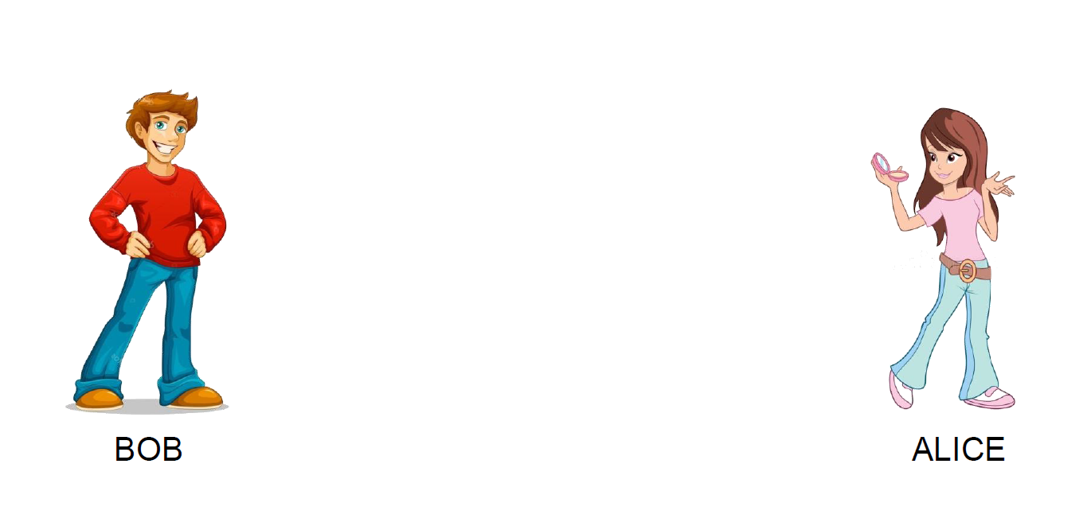

Cryptography Model - Bob & Alice

Slide 3

Cryptography Model - Bob & Alice

Slide 4

Cryptography Model - Bob & Alice

Slide 5

Cryptography Model - Bob & Alice

Slide 6

Cryptography Model - Bob & Alice

Slide 7





Cryptography Model - Eve

Slide 8


Cryptography Model - Eve
YEHEY!!

Slide 9

Cryptography Model - Encryption
Encrypted Message
Decrypted Message

Slide 10
Cryptography Model - Encryption
Encrypted Message
Decrypted Message

Slide 11
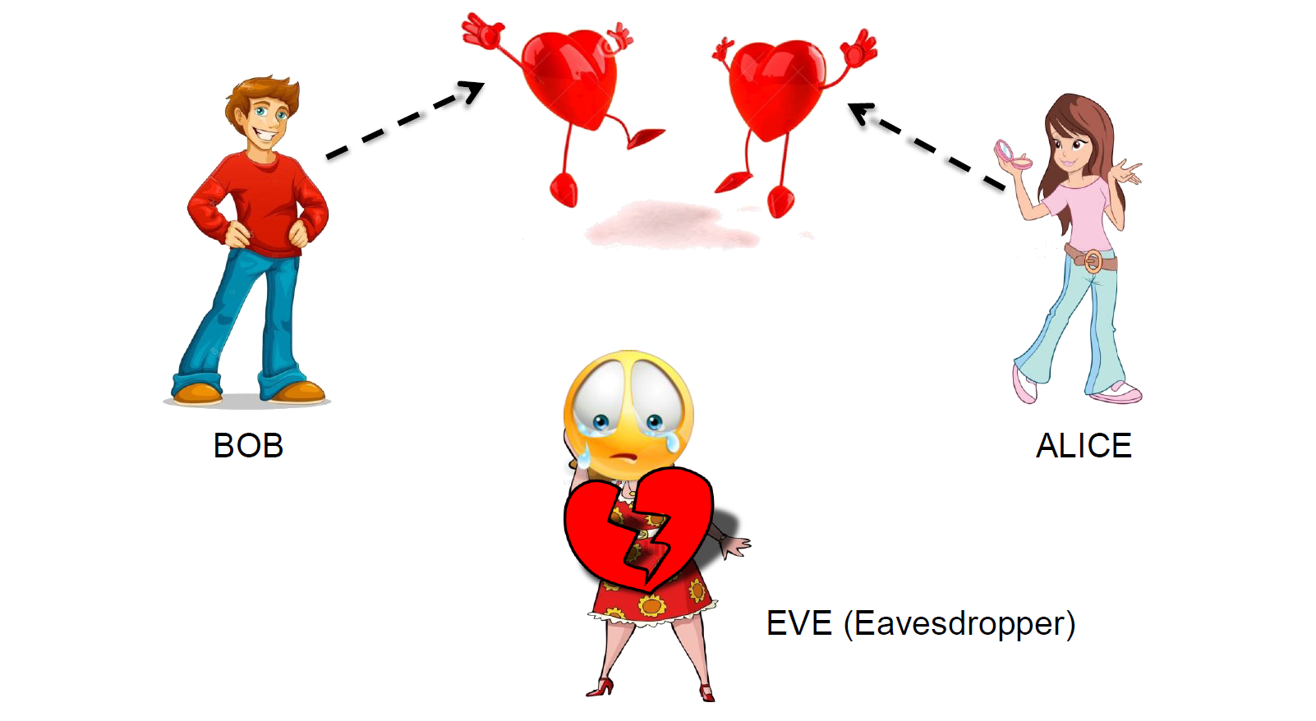
Cryptography Model - Encryption

Slide 12
What is Cryptography?
Cryptography is the study of encrypting and decrypting data to prevent unauthorized access.
Cryptography allows for the secure transmission of digital data between willing parties.
It is used to safeguard company secrets, secure classified information, and sensitive information from fraudulent activity, among other things.

Slide 13
Secure Communication
Confidentiality
Ensuring only the intended recipients in communication have access to the message.
Integrity
Ensuring that the message cannot be modified in transit without the other party being made aware.
Authentication
Ensuring the other party is indeed who they claim to be.
Anti-Replay
Ensuring the message cannot be maliciously re-transmitted.

Slide 14
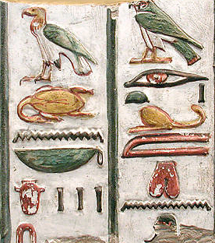
History of Cryptography
The history of cryptography finds its roots in Egypt around 4000 years ago. The Egyptians used hieroglyphics, the oldest cryptography technique, to communicate with each other.
In 500 BC, the technique was modified by replacing the characters with alphabets based on a secret rule known to only a few. This rule came to be known as the key to decipher hidden codes or messages.

Slide 15
Timeline of Cryptography
1,900 BCE - Monumental Hieroglyphs of the Old Kingdom of Egypt
1,500 BCE - Mesopotamian Secrets of Pottery
800 - Al-Kindi, "The Philosopher of the Arabs“
1467 - Leon Battista Alberti, "The Father of Western Cryptography“
1586 - The Babington Plot
1853 - Vigenère’s autokey cipher and the weaker Vigenère cipher
1917 - The Vernam Cipher
1923 - The Enigma Rotor Machine
1940 - Edgar Allan Poe Cracks the Code!
1942 - WW2 Japanese Navy Cryptography
1943 - The Colossus Computer

Slide 16
Timeline of Cryptography
1953 - The VIC Cipher
1975 - The Data Encryption Standard
1976 - Diffie-Hellman key exchange
1991 - Phil Zimmermann, PGP (Pretty Good Privacy)
2001 - Advanced Encryption Standard
2007 - NIST hash function competition announced.
2009 - Bitcoin network was launched.
2010 - The master key for High-bandwidth Digital Content Protection (HDCP) and the private signing key for the Sony PlayStation 3 game console are recovered and published using separate cryptanalytic attacks. PGP Corp. is acquired by Symantec.

Slide 17
Timeline of Cryptography
2012 - NIST selects the Keccak algorithm as the winner of its SHA-3 hash function competition.
2013 - Edward Snowden discloses a vast trove of classified documents from NSA. See Global surveillance disclosures (2013–present)
2013 - Dual_EC_DRBG is discovered to have a NSA backdoor.
2013 - NSA publishes Simon and Speck lightweight block ciphers.
2014 - The Password Hashing Competition accepts 24 entries.
2015 - Year by which NIST suggests that 80-bit keys be phased out.

Slide 18
Types of Cryptography
Cryptography is classified into two categories based on the types of keys and encryption algorithms:
Symmetric Key Cryptography (Secret key)
Asymmetric Key Cryptography (Public key)

Slide 19
Symmetric Key Cryptography
Uses a single key that only the sender and receiver know.
Key may come as a phrase, numbers or words
Messages must be encrypted with the key before sending.
Receiver must use the same key used in order to decrypt the message.

Slide 20
Asymmetric Key Cryptography
Consists of two keys, a private key, which is used by the receiver, and a public key, which is announced in the public.
Two different keys are used in this method to encrypt and decrypt the data. These two distinct keys are mathematically linked.
The public key is accessible to anyone, whereas the private key is only accessible to the person who generates these two keys.

Slide 21
Asymmetric Key Cryptography
Receiver:
creates Public and Private Key
Encrypted With Alice’s Public Key
PUBLIC KEY
Made available to the public
Decrypted With Private Key
PRIVATE KEY
Only Alice knows

Slide 22

STEGANOGRAPHY
Cryptographic Techniques
One of the oldest techniques of cryptography
Involves hiding secret information or messages within an ordinary, non-secret, file or message to avoid detection.
Early methods such as invisible ink and slight variations were used to hide messages.

Slide 23
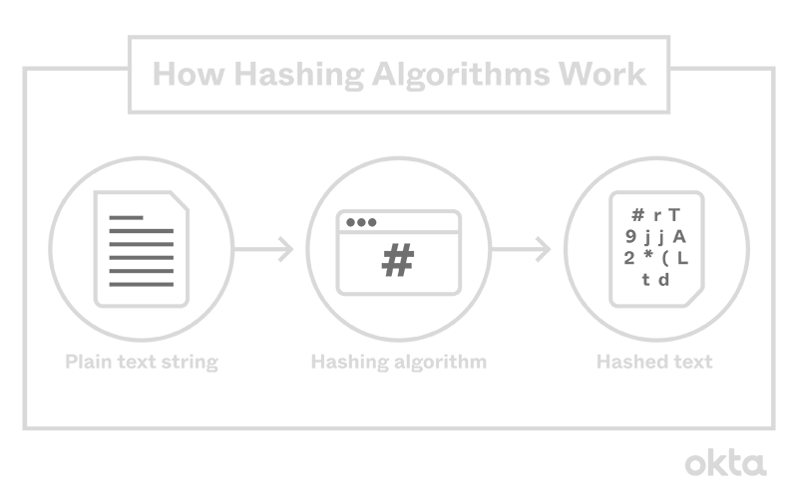
CRYPTOGRAPHIC HASHING
Cryptographic Techniques
One-way cryptographic function
Hashing converts data to be hidden into a unique string.
Irrespective of the type or form of data, hashing can be used to hide it.
Used for verification and hiding data

Slide 24
CIPHERS TO BE DISCUSSED
Cryptographic Techniques
Symmetric Cryptography
Caesar Cipher
Transposition Cipher
Asymmetric Cryptography
RSA (Rivest-Shamir-Adleman)

Slide 25
Caesar Cipher
Also known as Caesar's cipher, the shift cipher, Caesar's code or Caesar shift
One of the simplest and most widely known encryption techniques
a type of substitution cipher in which each letter in the plaintext is replaced by a letter some fixed number of positions down the alphabet.
The Caesar cipher is named after Julius Caesar, who, according to Suetonius, used it with a shift of three (A becoming D when encrypting, and D becoming A when decrypting) to protect messages of military significance.
The encryption step performed by a Caesar cipher is often incorporated as part of more complex schemes

Slide 26
Caesar Cipher
Pseudocode of Caesar Cypher
Identify the character within the sentence
Find that character’s location within the alphabet.
Identify that characters location + the key in the alphabet (if the location + key > 26, loop back around and begin counting at one.)
Build a new sentence using the new characters in place of the original characters.
repeat until sentence length is reached.
Return the result
Notes:
Identify the character within the sentence.

Slide 27
How it works
Shift: 10
A | B | C | D | E | F | G | H | I | J | K | L | M | N | O | P | Q | R | S | T | U | V | W | X | Y | Z
1 | 2 | 3 | 4 | 5 | 6 | 7 | 8 | 9 | 10 | 11 | 12 | 13 | 14 | 15 | 16 | 17 | 18 | 19 | 20 | 21 | 22 | 23 | 24 | 25 | 26
K | L | M | N | O | P | Q | R | S | T | U | V | W | X | Y | Z
1 | 2 | 3 | 4 | 5 | 6 | 7 | 8 | 9 | 10 | 11 | 12 | 13 | 14 | 15 | 16
A | B | C | D | E | F | G | H | I | J
17 | 18 | 19 | 20 | 21 | 22 | 23 | 24 | 25 | 26

Slide 28
How it works
Shift: 10
A | B | C | D | E | F | G | H | I | J | K | L | M | N | O | P | Q | R | S | T | U | V | W | X | Y | Z
K | L | M | N | O | P | Q | R | S | T | U | V | W | X | Y | Z | A | B | C | D | E | F | G | H | I | J
1 | 2 | 3 | 4 | 5 | 6 | 7 | 8 | 9 | 10 | 11 | 12 | 13 | 14 | 15 | 16 | 17 | 18 | 19 | 20 | 21 | 22 | 23 | 24 | 25 | 26
‘A’ + 10 = ‘K’
1 + 10 = 11

Slide 29
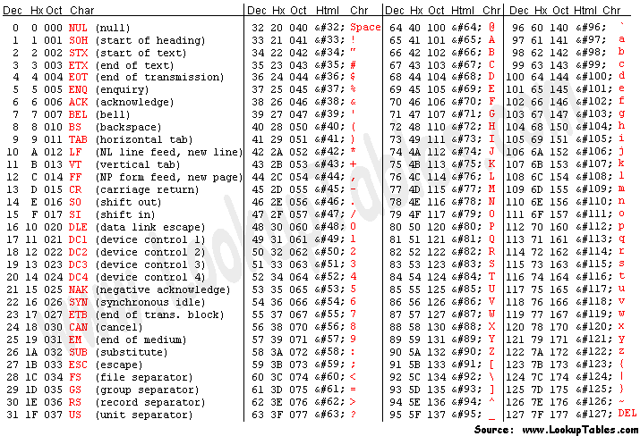
How it works

Slide 30
Simulation - Encryption
Original Message: CRYPTOGRAPHY
Shift: 12
M | N | O | P | Q | R | S | T | U | V | W | X | Y | Z
1 | 2 | 3 | 4 | 5 | 6 | 7 | 8 | 9 | 10 | 11 | 12 | 13 | 14
A | B | C | D | E | F | G | H | I | J | K | L | M | N | O | P | Q | R | S | T | U | V | W | X | Y | Z
1 | 2 | 3 | 4 | 5 | 6 | 7 | 8 | 9 | 10 | 11 | 12 | 13 | 14 | 15 | 16 | 17 | 18 | 19 | 20 | 21 | 22 | 23 | 24 | 25 | 26
A | B | C | D | E | F | G | H | I | J | K | L
15 | 16 | 17 | 18 | 19 | 20 | 21 | 22 | 23 | 24 | 25 | 26
‘A’ + 12 = ‘M’
1 + 12 = 13

Slide 31
Simulation - Encryption
Original Message: CRYPTOGRAPHY
Shift: 12
C | R | Y | P | T | O | G | R | A | P | H | Y
0 | 1 | 2 | 3 | 4 | 5 | 6 | 7 | 8 | 9 | 10 | 11
Original Message

Slide 32
Simulation - Encryption
Original Message: CRYPTOGRAPHY
Shift: 12
Output
C | R | Y | P | T | O | G | R | A | P | H | Y
0 | 1 | 2 | 3 | 4 | 5 | 6 | 7 | 8 | 9 | 10 | 11
O | R | Y | P | T | O | G | R | A | P | H | Y
0 | 1 | 2 | 3 | 4 | 5 | 6 | 7 | 8 | 9 | 10 | 11
(‘C’ - ‘A’ + 12) % 26 + ‘A’ = ‘O’
67 65 65 79
1st Traversal
A | B | C | D | E | F | G | H | I | J | K | L | M | N | O | P | Q | R | S | T | U | V | W | X | Y | Z
65 | 66 | 67 | 68 | 69 | 70 | 71 | 72 | 73 | 74 | 75 | 76 | 77 | 78 | 79 | 80 | 81 | 82 | 83 | 84 | 85 | 86 | 87 | 88 | 89 | 90

Slide 33
Simulation - Encryption
Original Message: CRYPTOGRAPHY
Shift: 12
Output
O | R | Y | P | T | O | G | R | A | P | H | Y
0 | 1 | 2 | 3 | 4 | 5 | 6 | 7 | 8 | 9 | 10 | 11
O | D | Y | P | T | O | G | R | A | P | H | Y
0 | 1 | 2 | 3 | 4 | 5 | 6 | 7 | 8 | 9 | 10 | 11
(‘R’ - ‘A’ + 12) % 26 + ‘A’ = ‘D’
82 65 65 68
2nd Traversal
A | B | C | D | E | F | G | H | I | J | K | L | M | N | O | P | Q | R | S | T | U | V | W | X | Y | Z
65 | 66 | 67 | 68 | 69 | 70 | 71 | 72 | 73 | 74 | 75 | 76 | 77 | 78 | 79 | 80 | 81 | 82 | 83 | 84 | 85 | 86 | 87 | 88 | 89 | 90

Slide 34
Simulation - Encryption
Original Message: CRYPTOGRAPHY
Shift: 12
Output
O | D | Y | P | T | O | G | R | A | P | H | Y
0 | 1 | 2 | 3 | 4 | 5 | 6 | 7 | 8 | 9 | 10 | 11
O | D | K | P | T | O | G | R | A | P | H | Y
0 | 1 | 2 | 3 | 4 | 5 | 6 | 7 | 8 | 9 | 10 | 11
(‘Y’ - ‘A’ + 12) % 26 + ‘A’ = ‘K’
89 65 65 75
3rd Traversal
A | B | C | D | E | F | G | H | I | J | K | L | M | N | O | P | Q | R | S | T | U | V | W | X | Y | Z
65 | 66 | 67 | 68 | 69 | 70 | 71 | 72 | 73 | 74 | 75 | 76 | 77 | 78 | 79 | 80 | 81 | 82 | 83 | 84 | 85 | 86 | 87 | 88 | 89 | 90

Slide 35
Simulation - Encryption
Original Message: CRYPTOGRAPHY
Shift: 12
Output
O | D | K | B | F | A | S | D | M | B | T | Y
0 | 1 | 2 | 3 | 4 | 5 | 6 | 7 | 8 | 9 | 10 | 11
O | D | K | B | F | A | S | D | M | B | T | K
0 | 1 | 2 | 3 | 4 | 5 | 6 | 7 | 8 | 9 | 10 | 11
(‘Y’ - ‘A’ + 12) % 26 + ‘A’ = ‘K’
89 65 65 75
12th Traversal
A | B | C | D | E | F | G | H | I | J | K | L | M | N | O | P | Q | R | S | T | U | V | W | X | Y | Z
65 | 66 | 67 | 68 | 69 | 70 | 71 | 72 | 73 | 74 | 75 | 76 | 77 | 78 | 79 | 80 | 81 | 82 | 83 | 84 | 85 | 86 | 87 | 88 | 89 | 90

Slide 36
Simulation - Encryption
Original Message: CRYPTOGRAPHY
Shift: 12
C | R | Y | P | T | O | G | R | A | P | H | Y
0 | 1 | 2 | 3 | 4 | 5 | 6 | 7 | 8 | 9 | 10 | 11
Original Message
O | D | K | B | F | A | S | D | M | B | T | K
0 | 1 | 2 | 3 | 4 | 5 | 6 | 7 | 8 | 9 | 10 | 11
Encrypted Message

Slide 37
Simulation - Decryption
Original Message: ODKBFASDMBTK
Shift: 12
M | N | O | P | Q | R | S | T | U | V | W | X | Y | Z | A | B | C | D | E | F | G | H | I | J | K | L
1 | 2 | 3 | 4 | 5 | 6 | 7 | 8 | 9 | 10 | 11 | 12 | 13 | 14 | 15 | 16 | 17 | 18 | 19 | 20 | 21 | 22 | 23 | 24 | 25 | 26
M | N | O | P | Q | R | S | T | U | V | W | X | Y | Z
13 | 14 | 15 | 16 | 17 | 18 | 19 | 20 | 21 | 22 | 23 | 24 | 25 | 26
A | B | C | D | E | F | G | H | I | J | K | L
1 | 2 | 3 | 4 | 5 | 6 | 7 | 7 | 9 | 10 | 11 | 12
‘M’ - 12 = ‘A’
13 - 12 = 1

Slide 38
Simulation - Decryption
Original Message: ODKBFASDMBTK
Shift: 12
O | D | K | B | F | A | S | D | M | B | T | K
0 | 1 | 2 | 3 | 4 | 5 | 6 | 7 | 8 | 9 | 10 | 11
Original Message

Slide 39
Simulation - Decryption
Original Message: ODKBFASDMBTK
Shift: 12
Output
O | D | K | B | F | A | S | D | M | B | T | K
0 | 1 | 2 | 3 | 4 | 5 | 6 | 7 | 8 | 9 | 10 | 11
C | D | K | B | F | A | S | D | M | B | T | K
0 | 1 | 2 | 3 | 4 | 5 | 6 | 7 | 8 | 9 | 10 | 11
(‘O’ - ‘A’ + 26 -12) % 26 + ‘A’ = ‘C’
1st Traversal
A | B | C | D | E | F | G | H | I | J | K | L | M | N | O | P | Q | R | S | T | U | V | W | X | Y | Z
65 | 66 | 67 | 68 | 69 | 70 | 71 | 72 | 73 | 74 | 75 | 76 | 77 | 78 | 79 | 80 | 81 | 82 | 83 | 84 | 85 | 86 | 87 | 88 | 89 | 90

Slide 40
Simulation - Decryption
Original Message: ODKBFASDMBTK
Shift: 12
Output
C | D | K | B | F | A | S | D | M | B | T | K
0 | 1 | 2 | 3 | 4 | 5 | 6 | 7 | 8 | 9 | 10 | 11
C | R | K | B | F | A | S | D | M | B | T | K
0 | 1 | 2 | 3 | 4 | 5 | 6 | 7 | 8 | 9 | 10 | 11
(‘D’ - ‘A’ + 26 -12) % 26 + ‘A’ = ‘R’
2nd Traversal
A | B | C | D | E | F | G | H | I | J | K | L | M | N | O | P | Q | R | S | T | U | V | W | X | Y | Z
65 | 66 | 67 | 68 | 69 | 70 | 71 | 72 | 73 | 74 | 75 | 76 | 77 | 78 | 79 | 80 | 81 | 82 | 83 | 84 | 85 | 86 | 87 | 88 | 89 | 90

Slide 41
Simulation - Decryption
Original Message: ODKBFASDMBTK
Shift: 12
Output
C | R | K | B | F | A | S | D | M | B | T | K
0 | 1 | 2 | 3 | 4 | 5 | 6 | 7 | 8 | 9 | 10 | 11
C | R | Y | B | F | A | S | D | M | B | T | K
0 | 1 | 2 | 3 | 4 | 5 | 6 | 7 | 8 | 9 | 10 | 11
(‘K’ - ‘A’ + 26 -12) % 26 + ‘A’ = ‘Y’
3rd Traversal
A | B | C | D | E | F | G | H | I | J | K | L | M | N | O | P | Q | R | S | T | U | V | W | X | Y | Z
65 | 66 | 67 | 68 | 69 | 70 | 71 | 72 | 73 | 74 | 75 | 76 | 77 | 78 | 79 | 80 | 81 | 82 | 83 | 84 | 85 | 86 | 87 | 88 | 89 | 90

Slide 42
Simulation - Decryption
Original Message: ODKBFASDMBTK
Shift: 12
Output
C | R | Y | P | T | O | G | R | A | P | H | K
0 | 1 | 2 | 3 | 4 | 5 | 6 | 7 | 8 | 9 | 10 | 11
C | R | Y | P | T | O | G | R | A | P | H | Y
0 | 1 | 2 | 3 | 4 | 5 | 6 | 7 | 8 | 9 | 10 | 11
(‘K’ - ‘A’ + 26 -12) % 26 + ‘A’ = ‘Y’
12th Traversal
A | B | C | D | E | F | G | H | I | J | K | L | M | N | O | P | Q | R | S | T | U | V | W | X | Y | Z
65 | 66 | 67 | 68 | 69 | 70 | 71 | 72 | 73 | 74 | 75 | 76 | 77 | 78 | 79 | 80 | 81 | 82 | 83 | 84 | 85 | 86 | 87 | 88 | 89 | 90

Slide 43
Simulation - Decryption
Original Message: ODKBFASDMBTK
Shift: 12
O | D | K | B | F | A | S | D | M | B | T | K
0 | 1 | 2 | 3 | 4 | 5 | 6 | 7 | 8 | 9 | 10 | 11
Encrypted Message
C | R | Y | P | T | O | G | R | A | P | H | Y
0 | 1 | 2 | 3 | 4 | 5 | 6 | 7 | 8 | 9 | 10 | 11
Decrypted Message

Slide 44
A Simple Exercise - Encryption
Shift: 5
Message To Be Encrypted
H | E | A | R | T
0 | 1 | 2 | 3 | 4
What would the encrypted message be ?
M | J | F | W | Y
0 | 1 | 2 | 3 | 4
Encrypted Message

Slide 45
A Simple Exercise - Decryption
Shift: 10
C | U | I | B | S | W
0 | 1 | 2 | 3 | 4 | 5
Encrypted Message
What would the decrypted message be ?
S | K | Y | R | I | M
0 | 1 | 2 | 3 | 4 | 5
Encrypted Message

Slide 46
Transposition Cipher
A method of encryption which scrambles the positions of characters (transposition) without changing the characters themselves.
Transposition ciphers reorder units of plaintext (typically characters or groups of characters) according to a regular system to produce a ciphertext which is a permutation of the plaintext.
Differs from substitution cypher (Caesar’s and RSA) where the former changes the plaintext unit themselves based on formula calculation, this kind of cypher merely change the position of the unit while keeping the unit composition the same
The first recorded instance of transposition cypher is with the Spartan scytale

Slide 47
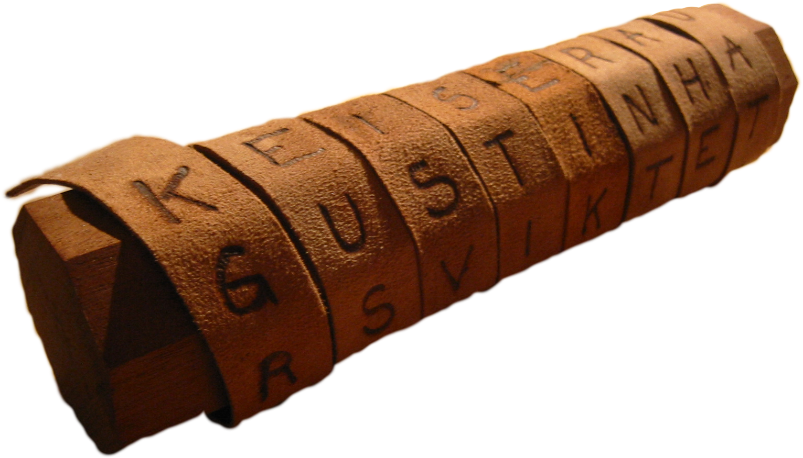
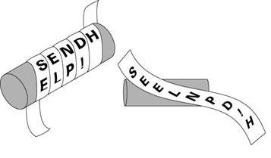
Notes:
The sender would write the message along the length of the scytale and then unwind the strip. The leather strip would then appear to carry a list of meaningless letters. To recover the message, the receiver would simply wrap the leather strip around a scytale of the exact same diameter as the one used by the sender

Slide 48
How it works
ENCRYPTION | DECRYPTION
Step 1: Get message and keyword
Step 1: Get message and keyword
Step 2: Get the length of the message and keyword
Step 2: Get the length of the message and keyword
Step 3: Get the row and column lengths
Step 3: Get the row and column lengths
Step 4: Create a matrix and insert the message in the matrix
Step 4: Create a matrix and insert the message in the matrix
Step 5: Rearrange the columns according to alphabetical order of the keyword
Step 5: Rearrange the columns according to the keyword
Step 6: Output each column of the matrix
Step 6: Output each row of the matrix

Slide 49
Simulation - Encryption
Step 1: Get message and keyword
Message: CRYPTOGRAPHY
Keyword: CATS

Slide 50
Simulation - Encryption
Step 2: Get the length of the message and keyword
CRYPTOGRAPHY = 12
CATS = 4

Slide 51
Simulation - Encryption
Step 3: Get the row and column lengths
Row = messageLength / keyLength
= 12 / 4
= 3
Column = keyLength
= 4

Slide 52
Simulation - Encryption
Step 4: Create a matrix and insert the message in the matrix
C | R | Y | P
C | A | T | S
T | O | G | R
A | P | H | Y
matrix[3][4] =

Slide 53
Simulation - Encryption
Step 5: Rearrange the columns according to alphabetical order of the keyword
C | A | T | S
C | R | Y | P
T | O | G | R
A | P | H | Y
A
R
O
P
 | C
 | C
 | T
 | A
 |  |  | T
 |  |  | Y
 |  |  | G
 |  |  | H
 |  | S
 |  | P
 |  | R
 |  | Y

Slide 54
Simulation - Encryption
Step 6: Output each column of the matrix
A | C | S | T
R | C | P | Y
O | T | R | G
P | A | Y | H
ENCRYPTED MESSAGE:
ROP
CTA
PRY
YGH

Slide 55
Simulation - Decryption
Step 1: Get message and keyword
Message: ROPCTAPRYYGH
Keyword: CATS

Slide 56
Simulation - Decryption
Step 2: Get the length of the message and keyword
ROPCTAPRYYGH = 12
CATS = 4

Slide 57
Simulation - Decryption
Step 3: Get the row and column lengths
Row = messageLength / keyLength
= 12 / 4
= 3
Column = key length
= 4

Slide 58
Simulation - Decryption
Step 4: Create a matrix and insert the message in the matrix
R
O
P
 | C
 | T
 | A
 |  |  | Y
 |  |  | G
 |  |  | H
 |  | P
 |  | R
 |  | Y
A | C | S | T
matrix[3][4] =

Slide 59
Simulation - Decryption
Step 5: Rearrange the columns according to the keyword
A | C | S | T
R | C | P | Y
O | T | R | G
P | A | Y | H
C
C
T
A
 | A
 | R
 | O
 | P
 |  |  | S
 |  |  | P
 |  |  | R
 |  |  | Y
 |  | T
 |  | Y
 |  | G
 |  | H

Slide 60
Simulation - Decryption
Step 6: Output each row of the matrix
C | A | T | S
C | R | Y | P
T | O | G | R
A | P | H | Y
DECRYPTED MESSAGE:
CRYP
TOGR
APHY

Slide 61
A Simple Exercise - Transposition
Message: rs-lyAi-Celtaoxomdptghnmi
Key: MOUSE
What would be the original message?
Algorithms-and-Complexity

Slide 62
RSA Algorithm
Utilizes asymmetric encryption
RSA stands for Ron Rivest, Adi Shamir, and Leonard Adleman, who first publicly described it in 1978
Notes:
It utilizes asymmetric encryption which requires 2 keys, a public key and private key
The “RSA” comes from the first letters of their surname, Rivest, Shamir, and Adleman
The prime factors must be kept secret. Anyone can use the public key to encrypt a message, but with currently published methods, if the public key is large enough, only someone with knowledge of the prime factors can feasibly decode the message
The prime factors must be kept secret. Anyone can use the public key to encrypt a message, but with currently published methods, if the public key is large enough, only someone with knowledge of the prime factors can feasibly decode the message.

Slide 63
How it works
CREATE ENCRYPTION AND DECRYPTION KEY
Step 1: Get two prime numbers
Step 2: Get the product of the two prime numbers (n)
Step 3: Find the totient of n
Step 4: Choose a number for encryption key
Step 5: Choose a number for decryption key

Slide 64
How it works
ENCRYPTION | DECRYPTION
Step 1: Get message
Step 1: Get message
Step 2: Get the encryption key
Step 2: Get the decryption key
Step 3: Apply the formula to each letter of the message
Step 3: Apply the formula to each letter of the message
c = (m^{key}) mod (n)
c = (m^{key}) mod (n)

Slide 65
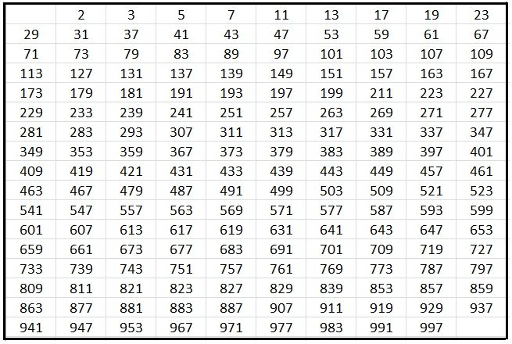
Simulation - Create Key
Step 1: Get two prime numbers
p = 5
q = 11
Notes:
And i number is prime if it is not divisible by any number except by one and the number itself

Slide 66
Simulation - Create Key
Step 2: Get the product of the two prime numbers
p = 5 q = 11
n = p(q)
= 5(11)
= 55

Slide 67
Simulation - Create Key
Step 3: Find the totient of n (version 1)
Totient = Φ(n)
= Φ(55)
= ?

Slide 68
Simulation - Create Key
Step 3: Find the totient of n (version 1)
Totient = Φ(n)
1 , 2, 3, 4, 5, 6, 7, 8, 9,10
11,12,13,14,15,16,17,18,19,20
21,22,23,24,25,26,27,28,29,30
31,32,33,34,35,36,37,38,39,40
41,42,43,44,45,46,47,48,49,50
51,52,53,54,55
= Φ(55)
Notes:
First we count all the numbers from 1 to n, here our n is 55. How did we get our n again? The n is the product of our two primes, 11 and 5.

Slide 69
Simulation - Create Key
Step 3: Find the totient of n (version 1)
Totient = Φ(n)
1 , 2, 3, 4, 5, 6, 7, 8, 9,10
11,12,13,14,15,16,17,18,19,20
21,22,23,24,25,26,27,28,29,30
31,32,33,34,35,36,37,38,39,40
41,42,43,44,45,46,47,48,49,50
51,52,53,54,55
= Φ(55)
Notes:
Here we will remove the numbers that has a common factor of our 2 primes, 11 and 5

Slide 70
Simulation - Create Key
Step 3: Find the totient of n (version 1)
Totient = Φ(n)
1, 2, 3, 4, 6, 7, 8, 9,
12,13,14,16,17,18,19
21,23,24,26,27,28,29
31,32,34,36,37,38,39
41,42,43,46,47,48,49
51,52,53,54
= Φ(55)
= 40
Notes:
Once we remove them from our list, we count how many numbers are remaining. And we see that there are 40 numbers. So, our totient is 40. This is a long process to do manually. We can make get our totient in an instant in the alternate version

Slide 71
Simulation - Create Key
Step 3: Find the totient of n (version 2)
Totient = Φ(n)
= (p - 1)(q - 1)
= (5 - 1)(11 - 1)
= (4)(10)
= 40
Notes:
So instead of using the phi of n, we can instead do this formula. P-1 * q -1.

Slide 72
Simulation - Create Key
Step 4: Choose a number for encryption key (eKey)
Rules:
Should be 1 < eKey < Φ(n)
Should be coprime with n and Φ(n)
n = 55 totient = 40

Slide 73
Simulation - Create Key
Step 4: Choose a number for encryption key
1 < eKey < 40
2 ,3, 4, 5, 6, 7, 8, 9, 10 , 11, 12, 13, 14, 15, 16, 17, 18, 19, 20, 21, 22, 23, 24, 25, 26, 27, 28, 29, 30, 31, 32, 33, 34, 35, 36, 37, 38, 39
Notes:
First we list down the numbers that satisfy this condition, so this would be numbers 2 to 39

Slide 74
Simulation - Create Key
Step 4: Choose a number for encryption key
Factors of 40 and 55
1, 2, 4, 5, 8, 10, 11, 20, 40
Coprime with 40
3, 7, 9, 13, 17, 19, 23, 29, 31, 37
eKey = 7
Notes:
Now we have our list of coprimes with 40. Here we are free to select any number to be our encryption key, for this presentation, our ekey will be 7

Slide 75
Simulation - Create Key
Step 5: Choose a number for decryption key (version 1)
dKey(eKey) = 1 mod (Φ(n))
dKey(7) = 1 mod 40

Slide 76
Simulation - Create Key
Step 5: Choose a number for decryption key (version 1)
dKey(eKey) = 1 mod (Φ(n))
dKey(7) = 1 mod 40

Slide 77
Simulation - Create Key
Step 5: Choose a number for decryption key (version 1)
dKey(eKey) = 1 mod (Φ(n))
dKey(7) = 1 mod 40
Euclidean Algorithm
40 =
Notes:
Here in this first version, we perform something thats called the euclidean algorithm.

Slide 78
Simulation - Create Key
Step 5: Choose a number for decryption key (version 1)
dKey(eKey) = 1 mod (Φ(n))
dKey(7) = 1 mod 40
Euclidean Algorithm
40 = (7)
Notes:
First we find out how many times 7 goes into 40, our answer is 5 times

Slide 79
Simulation - Create Key
Step 5: Choose a number for decryption key (version 1)
dKey(eKey) = 1 mod (Φ(n))
dKey(7) = 1 mod 40
Euclidean Algorithm
40 = (7)5
Notes:
First we find out how many times 7 goes into 40, our answer is 5 times

Slide 80
Simulation - Create Key
Step 5: Choose a number for decryption key (version 1)
dKey(eKey) = 1 mod (Φ(n))
dKey(7) = 1 mod 40
Euclidean Algorithm
40 = (7)5 + 5
Notes:
With a remainder of 5

Slide 81
Simulation - Create Key
Step 5: Choose a number for decryption key (version 1)
40 = (7)5 + 5
7 = 5
Notes:
Here, we bring 7 to the other side of the equation

Slide 82
Simulation - Create Key
Step 5: Choose a number for decryption key (version 1)
40 = (7)5 + 5
7 = (5)
Notes:
Here, we bring 7 to the other side of the equation and retain our remainder five on the other side
we find out how many times 5 goes into 7, our answer is 1 time with a remainder of 2

Slide 83
Simulation - Create Key
Step 5: Choose a number for decryption key (version 1)
40 = (7)5 + 5
7 = (5)
Notes:
we find out how many times 5 goes into 7, our answer is 1 time with a remainder of 2

Slide 84
Simulation - Create Key
Step 5: Choose a number for decryption key (version 1)
40 = (7)5 + 5
7 = 1(5) + 2
Notes:
we find out how many times 5 goes into 7, our answer is 1 time with a remainder of 2
And like the previous ones, we now bring 5 to the other side and perform the same steps

Slide 85
Simulation - Create Key
Step 5: Choose a number for decryption key (version 1)
40 = (7)5 + 5
7 = 1(5) + 2
5 = 2(2) + 1
Notes:
Now we are at the last non-zero remainder, we then use the extended euclidean algorithm

Slide 86
Simulation - Create Key
Step 5: Choose a number for decryption key (version 1)
Euclidean Algorithm
Extended Euclidean Algorithm
40 = (7)5 + 5
1 =
7 = 1(5) + 2
5 = 2(2) + 1
Notes:
We start with 1 because that was our last result.

Slide 87
Simulation - Create Key
Step 5: Choose a number for decryption key (version 1)
Euclidean Algorithm
Extended Euclidean Algorithm
40 = (7)5 + 5
1 = 5 - 2(2)
7 = 1(5) + 2
5 = 2(2) + 1
Notes:
From the left side we know that 1 = 5 -2(2).
We then proceed to make successive substitutions for the remains for the euclidean algorithm

Slide 88
Simulation - Create Key
Step 5: Choose a number for decryption key (version 1)
Euclidean Algorithm
Extended Euclidean Algorithm
40 = (7)5 + 5
1 = 5 - 2(2)
7 = 1(5) + 2
1 = 5 -2(7 - 5(1))
5 = 2(2) + 1
Notes:
So now we substitute this two from this line.
Afterwards we distribute the -2 and we get this result

Slide 89
Simulation - Create Key
Step 5: Choose a number for decryption key (version 1)
Euclidean Algorithm
Extended Euclidean Algorithm
40 = (7)5 + 5
1 = 5 - 2(2)
7 = 1(5) + 2
1 = 5 -2(7 - 1(5))
1 = 5 - 2(7) + 2(5)
5 = 2(2) + 1
Notes:
So now we substitute this two from this line.
Afterwards we distribute the -2 and we get this result
And if combine the common values, 5 and 2 times 5

Slide 90
Simulation - Create Key
Step 5: Choose a number for decryption key (version 1)
Euclidean Algorithm
Extended Euclidean Algorithm
40 = (7)5 + 5
1 = 5 - 2(2)
1 = 5 -2(7 - 1(5))
7 = 1(5) + 2
1 = 5 - 2(7) + 2(5)
5 = 2(2) + 1
1 = 3(5) - 2(7)
Notes:
This will be our result and then we substitute this 5 from this line

Slide 91
Simulation - Create Key
Step 5: Choose a number for decryption key (version 1)
Euclidean Algorithm
Extended Euclidean Algorithm
40 = (7)5 + 5
1 = 5 - 2(2)
1 = 5 -2(7 - 1(5))
7 = 1(5) + 2
1 = 5 - 2(7) + 2(5)
5 = 2(2) + 1
1 = 3(5) - 2(7)
1 = 3(40 - 5(7)) - 2(7)
Notes:
This will be our result and then we substitute this 5 from this line

Slide 92
Simulation - Create Key
Step 5: Choose a number for decryption key (version 1)
Euclidean Algorithm
Extended Euclidean Algorithm
40 = (7)5 + 5
1 = 3(40 - 5(7)) - 2(7)
7 = 1(5) + 2
1 = 3(40) - 15(7) - 2(7)
5 = 2(2) + 1
Notes:
We first distribute the 3

Slide 93
Simulation - Create Key
Step 5: Choose a number for decryption key (version 1)
Euclidean Algorithm
Extended Euclidean Algorithm
40 = (7)5 + 5
1 = 3(40 - 5(7)) - 2(7)
7 = 1(5) + 2
1 = 3(40) - 15(7) - 2(7)
5 = 2(2) + 1
Notes:
We then combine these two common values

Slide 94
Simulation - Create Key
Step 5: Choose a number for decryption key (version 1)
Euclidean Algorithm
Extended Euclidean Algorithm
40 = (7)5 + 5
1 = 3(40 - 5(7)) - 2(7)
7 = 1(5) + 2
1 = 3(40) - 15(7) - 2(7)
5 = 2(2) + 1
1 = 3(40) - 17(7)
Notes:
We then combine these two common values

Slide 95
Simulation - Create Key
Step 5: Choose a number for decryption key (version 1)
Euclidean Algorithm
Extended Euclidean Algorithm
40 = (7)5 + 5
1 = 3(40 - 5(7)) - 2(7)
7 = 1(5) + 2
1 = 3(40) - 15(7) - 2(7)
5 = 2(2) + 1
1 = 3(40) - 17(7)
Notes:
We now have our original values, our totient which is 40 and which is our encryption key 7.
The important number is what is paired with our encryption key, 7, this is -17. If this number was positive. It would be our decryption key
But because it is negative we calculate….

Slide 96
Simulation - Create Key
Step 5: Choose a number for decryption key (version 1)
Euclidean Algorithm
Extended Euclidean Algorithm
40 = (7)5 + 5
1 = 3(40 - 5(7)) - 2(7)
7 = 1(5) + 2
1 = 3(40) - 15(7) - 2(7)
5 = 2(2) + 1
1 = 3(40) - 17(7)
dKey = -17 mod 40
Notes:
Our decryption key is -17 mod 40.
We get the result of

Slide 97
Simulation - Create Key
Step 5: Choose a number for decryption key (version 1)
Euclidean Algorithm
Extended Euclidean Algorithm
40 = (7)5 + 5
1 = 3(40 - 5(7)) - 2(7)
7 = 1(5) + 2
1 = 3(40) - 15(7) - 2(7)
5 = 2(2) + 1
1 = 3(40) - 17(7)
dKey = 23
Notes:
23, thus this will be our decryption key

Slide 98
Simulation - Create Key
Step 5: Choose a number for decryption key (version 2)
dKey = dKey*eKey(mod(totient) = 1
dKey = dkey*7 mod 40 = 1
Notes:
In the 2nd version, the one we are more familiar with, the one provided by sir godwin.
In this one our decryption key has to satisfy this equation.

Slide 99
Simulation - Create Key
Step 5: Choose a number for decryption key (version 2)
dKey = dKey*eKey(mod(totient) = 1
dKey = dkey*7 mod 40 = 1
1 | 2 | 3 | 4 | 5 | 6 | 7 | 8 | 9 | 10 | 11 | 13 | 14 | 15 | 16 | 17 | 18 | 19 | … | 23
7 | 14 | 21 | 28 | 35 | 2 | 9 | 16 | 23 | 30 | 37 | 4 | 11 | 18 | 25 | 39 | 6 | 13 |  | 1

Slide 100
Simulation - Encryption
Step 1: Get message
Message: CRYPTOGRAPHY

Slide 101
Simulation - Encryption
Step 2: Get encryption key
Encryption Key = 7

Slide 102
Simulation - Encryption
Step 3: Apply the formula to each letter of the message
C | R | Y | P | T | O | G | R | A | P | H | Y
0 | 1 | 2 | 3 | 4 | 5 | 6 | 7 | 8 | 9 | 10 | 11
3 | 18 | 25 | 16 | 20 | 15 | 7 | 18 | 1 | 16 | 8 | 25
0 | 1 | 2 | 3 | 4 | 5 | 6 | 7 | 8 | 9 | 10 | 11

Slide 103
Simulation - Encryption
Step 3: Apply the formula to each letter of the message
3 | 18 | 25 | 16 | 20 | 15 | 7 | 18 | 1 | 16 | 8 | 25
0 | 1 | 2 | 3 | 4 | 5 | 6 | 7 | 8 | 9 | 10 | 11
1st Traversal
Formula:
c = m^eKey mod (n)
m = ‘c’ = 3
n = 55
eKey = 7
(3⁷) mod (55)
Output
42 | 18 | 25 | 16 | 20 | 15 | 7 | 18 | 1 | 16 | 8 | 25
0 | 1 | 2 | 3 | 4 | 5 | 6 | 7 | 8 | 9 | 10 | 11
Notes:
In this formula
M is the plaintext
C is the ciphertext
Our n is the product of the two primes
And e is our encryption key

Slide 104
Simulation - Encryption
Step 3: Apply the formula to each letter of the message
42 | 18 | 25 | 16 | 20 | 15 | 7 | 18 | 1 | 16 | 8 | 25
0 | 1 | 2 | 3 | 4 | 5 | 6 | 7 | 8 | 9 | 10 | 11
2nd Traversal
Formula:
c = m^eKey mod (n)
m = ‘r’ = 18
n = 55
eKey = 7
(18⁷) mod (55)
Output
42 | 17 | 25 | 16 | 20 | 15 | 7 | 18 | 1 | 16 | 8 | 25
0 | 1 | 2 | 3 | 4 | 5 | 6 | 7 | 8 | 9 | 10 | 11

Slide 105
Simulation - Encryption
Step 3: Apply the formula to each letter of the message
42 | 17 | 25 | 16 | 20 | 15 | 7 | 18 | 1 | 16 | 8 | 25
0 | 1 | 2 | 3 | 4 | 5 | 6 | 7 | 8 | 9 | 10 | 11
3rd Traversal
Formula:
c = m^eKey mod (n)
m = ‘y’ = 25
n = 55
eKey = 7
(25⁷) mod (55)
Output
42 | 17 | 20 | 16 | 20 | 15 | 7 | 18 | 1 | 16 | 8 | 25
0 | 1 | 2 | 3 | 4 | 5 | 6 | 7 | 8 | 9 | 10 | 11

Slide 106
Simulation - Encryption
Step 3: Apply the formula to each letter of the message
42 | 17 | 20 | 36 | 15 | 5 | 28 | 17 | 1 | 36 | 2 | 25
0 | 1 | 2 | 3 | 4 | 5 | 6 | 7 | 8 | 9 | 10 | 11
12th Traversal
Formula:
c = m^eKey mod (n)
m = ‘y’ = 25
n = 55
eKey = 7
(25⁷) mod (55)
Output
42 | 17 | 20 | 36 | 15 | 5 | 28 | 17 | 1 | 36 | 2 | 20
0 | 1 | 2 | 3 | 4 | 5 | 6 | 7 | 8 | 9 | 10 | 11

Slide 107
Simulation - Encryption
Step 3: Apply the formula to each letter of the message
42 | 17 | 20 | 36 | 15 | 5 | 28 | 17 | 1 | 36 | 2 | 20
0 | 1 | 2 | 3 | 4 | 5 | 6 | 7 | 8 | 9 | 10 | 11
Encrypted Message
P | Q | T | J | O | E | B | Q | A | J | B | T
0 | 1 | 2 | 3 | 4 | 5 | 6 | 7 | 8 | 9 | 10 | 11
Cipher Text
Notes:
Now here is our encrypted message

Slide 108
Simulation - Decryption
Step 1: Get message
Message:
42 | 17 | 20 | 36 | 15 | 5 | 28 | 17 | 1 | 36 | 2 | 20

Slide 109
Simulation - Decryption
Step 2: Get Decryption key
Decryption Key = 23

Slide 110
Simulation - Decryption
Step 3: Apply the formula to each letter of the message
42 | 17 | 20 | 36 | 15 | 5 | 28 | 17 | 1 | 36 | 2 | 20
0 | 1 | 2 | 3 | 4 | 5 | 6 | 7 | 8 | 9 | 10 | 11
1st Traversal
Formula:
m = c^dKey mod (n)
c = 42
n = 55
dKey = 23
(42²³) mod (55)
3 | 17 | 20 | 36 | 15 | 5 | 28 | 17 | 1 | 36 | 2 | 20
0 | 1 | 2 | 3 | 4 | 5 | 6 | 7 | 8 | 9 | 10 | 11
Output

Slide 111
Simulation - Decryption
Step 3: Apply the formula to each letter of the message
3 | 18 | 20 | 36 | 15 | 5 | 28 | 17 | 1 | 36 | 2 | 20
0 | 1 | 2 | 3 | 4 | 5 | 6 | 7 | 8 | 9 | 10 | 11
2nd Traversal
Formula:
m = c^dKey mod (n)
c = 18
n = 55
dKey = 23
(18⁷) mod (55)
3 | 17 | 20 | 36 | 15 | 5 | 28 | 17 | 1 | 36 | 2 | 20
0 | 1 | 2 | 3 | 4 | 5 | 6 | 7 | 8 | 9 | 10 | 11
Output

Slide 112
Simulation - Decryption
Step 3: Apply the formula to each letter of the message
3 | 17 | 20 | 36 | 15 | 5 | 28 | 17 | 1 | 36 | 2 | 20
0 | 1 | 2 | 3 | 4 | 5 | 6 | 7 | 8 | 9 | 10 | 11
3rd Traversal
Formula:
m = c^dKey mod (n)
c = 20
n = 55
dKey = 23
(20²³) mod (55)
3 | 17 | 25 | 36 | 15 | 5 | 28 | 17 | 1 | 36 | 2 | 20
0 | 1 | 2 | 3 | 4 | 5 | 6 | 7 | 8 | 9 | 10 | 11
Output

Slide 113
Simulation - Decryption
Step 3: Apply the formula to each letter of the message
3 | 18 | 25 | 16 | 20 | 15 | 7 | 18 | 1 | 16 | 8 | 20
0 | 1 | 2 | 3 | 4 | 5 | 6 | 7 | 8 | 9 | 10 | 11
12th Traversal
Formula:
m = c^dKey mod (n)
c = 25
n = 55
dKey = 23
(25⁷) mod (55)
3 | 18 | 25 | 16 | 20 | 15 | 7 | 18 | 1 | 16 | 8 | 25
0 | 1 | 2 | 3 | 4 | 5 | 6 | 7 | 8 | 9 | 10 | 11
Output

Slide 114
Simulation - Decryption
Step 3: Apply the formula to each letter of the message
3 | 18 | 25 | 16 | 20 | 15 | 7 | 18 | 1 | 16 | 8 | 25
0 | 1 | 2 | 3 | 4 | 5 | 6 | 7 | 8 | 9 | 10 | 11
Decrypted Message
C | R | Y | P | T | O | G | R | A | P | H | Y
0 | 1 | 2 | 3 | 4 | 5 | 6 | 7 | 8 | 9 | 10 | 11

Slide 115
Recap on how it works
CREATE ENCRYPTION AND DECRYPTION KEY
Step 1: Get two prime numbers (p = 5, q = 11)
p,q | 5,11
n | 55
Φ(n) | 40
Step 2: Get the product of the two prime numbers (n = p*q)
Step 3: Find the totient of n (phi(n) = (p-1)*(q-1))
Step 4: Choose a number for encryption key
Step 5: Choose a number for decryption key

Slide 116
Simulation - Create Key
Step 4: Choose a number for encryption key (eKey)
Rules:
Should be 1 < eKey < Φ(n)
Should be coprime with n
Notes:
Co primes are numbers that share no common factor with a number

Slide 117
Simulation - Create Key
Step 4: Choose a number for encryption key
Factors of 40 and 55
1, 2, 4, 5, 8, 10, 11, 20, 40
Coprime with 40
3, 7, 9, 13, 17, 19, 23, 29, 31, 37
eKey = 7
Notes:
Now we have our list of coprimes with 40. Here we are free to select any number to be our encryption key, for this presentation, our ekey will be 7

Slide 118
Simulation - Create Key
Step 5: Choose a number for decryption key (version 1)
Formula for dKey = dKey*eKey(modΦ(n)) = 1
d*7(mod 40) = 1

Slide 119
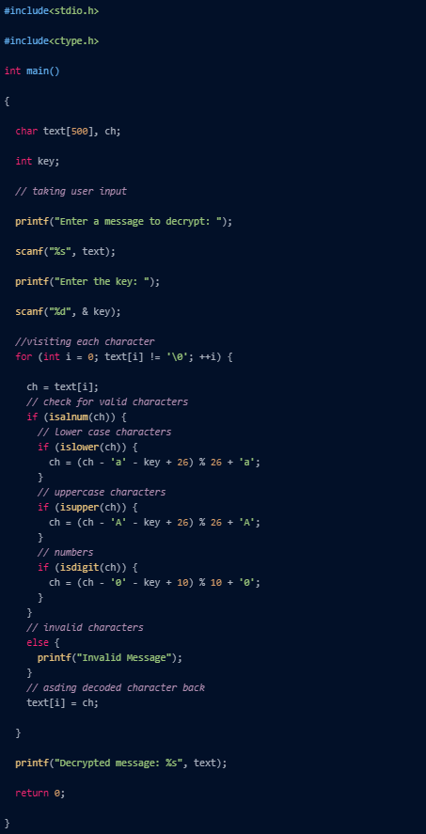
Streamline Code - Caesar Cipher
INTERNET CODE - ENCRYPTION

Slide 120
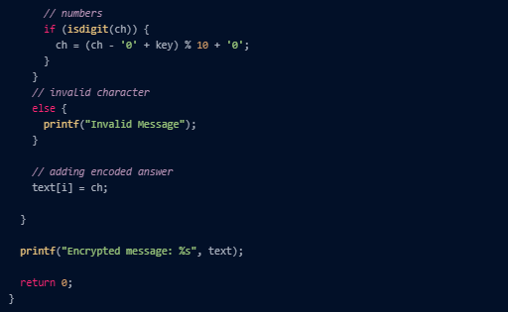
Streamline Code - Caesar Cipher
INTERNET CODE - DECRYPTION

Slide 121
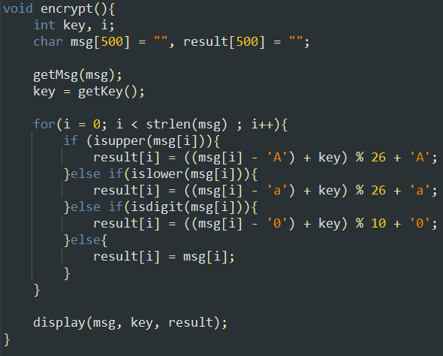
Streamline Code - Caesar Cipher
GROUP CODE - ENCRYPTION

Slide 122
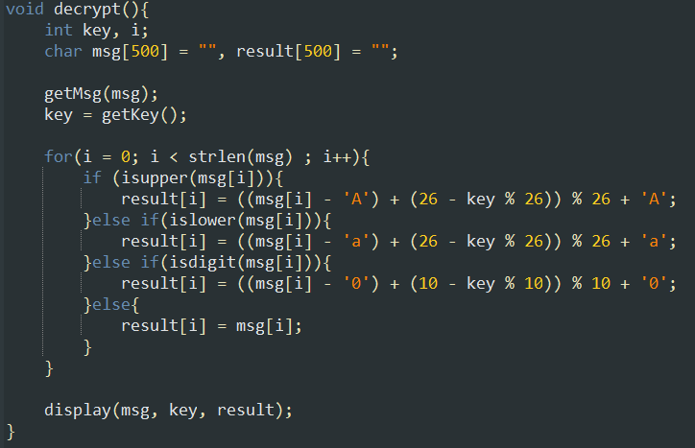
Streamline Code - Caesar Cipher
GROUP CODE - DECRYPTION

Slide 123
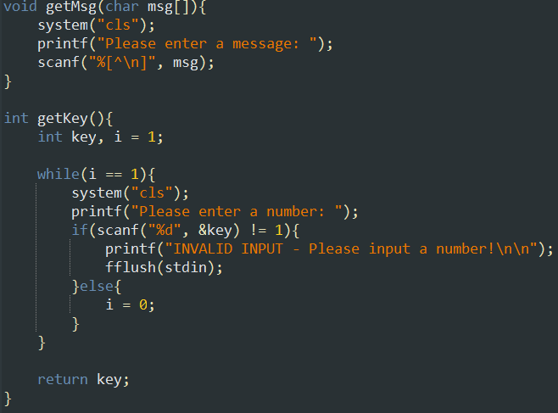
Streamline Code - Caesar Cipher
GROUP CODE - FUNCTIONS

Slide 124
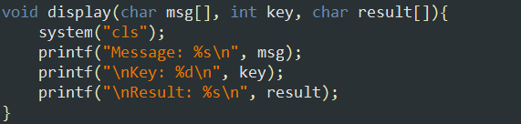
Streamline Code - Caesar Cipher
GROUP CODE - FUNCTIONS

Slide 125
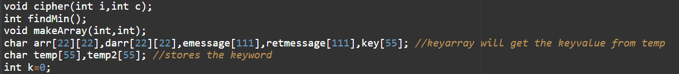
Streamline Code - Transposition Cipher
INTERNET CODE

Slide 126
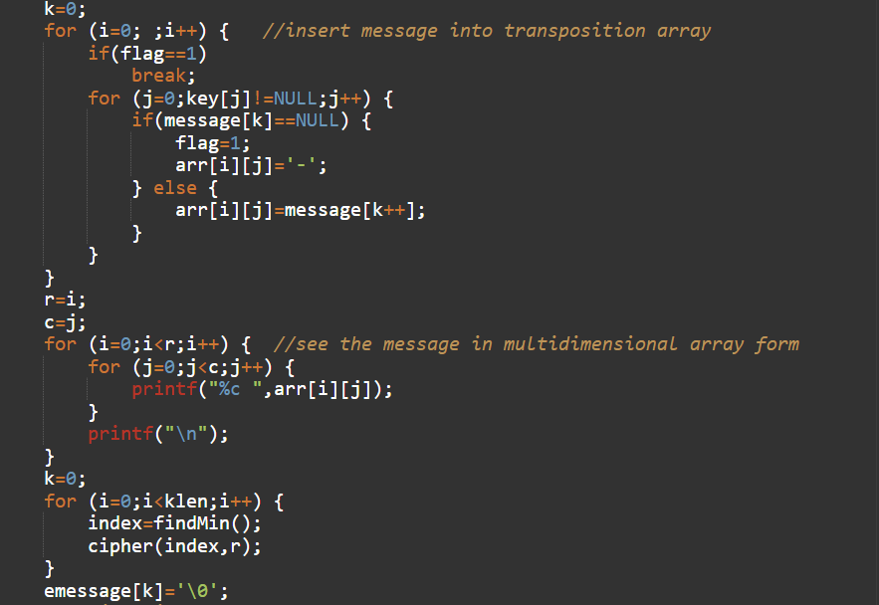
Streamline Code - Transposition Cipher
INTERNET CODE

Slide 127
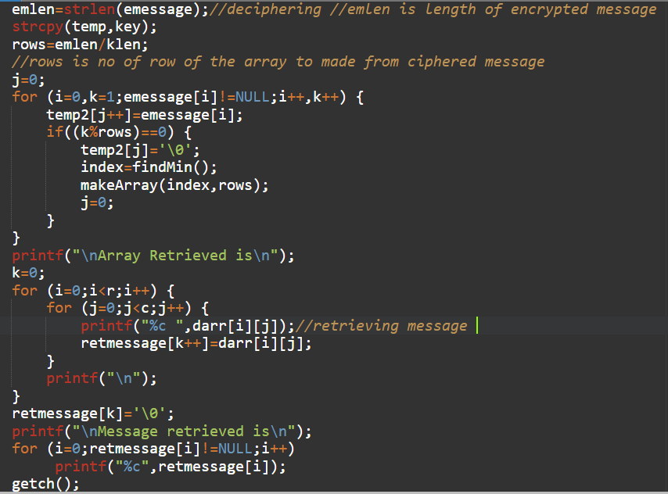
Streamline Code - Transposition Cipher
INTERNET CODE

Slide 128
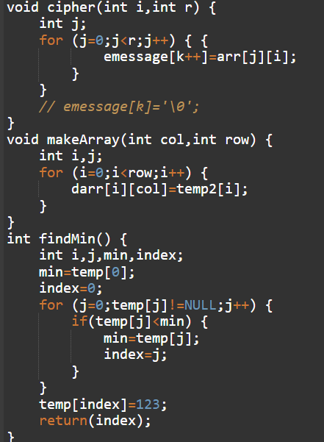

Slide 129
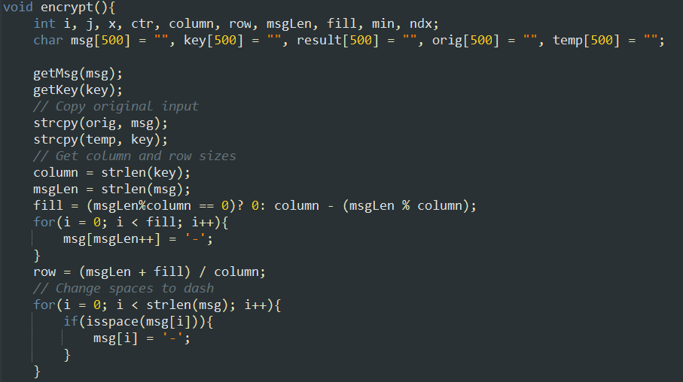
Streamline Code - Transposition Cipher
GROUP CODE - ENCRYPTION

Slide 130
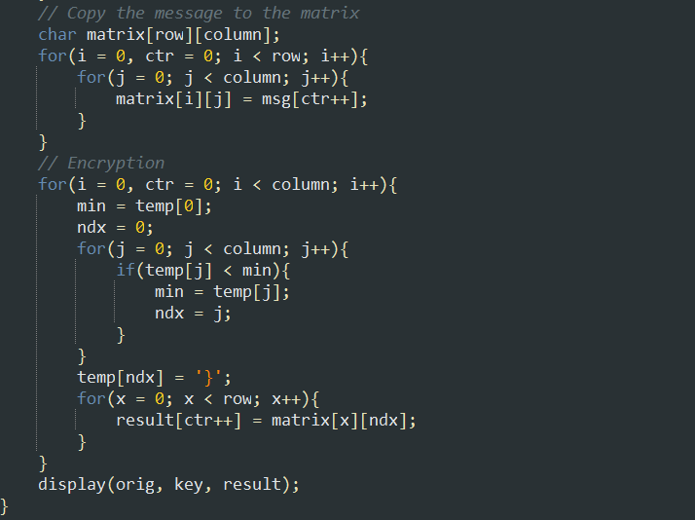
Streamline Code - Transposition Cipher
GROUP CODE - ENCRYPTION

Slide 131
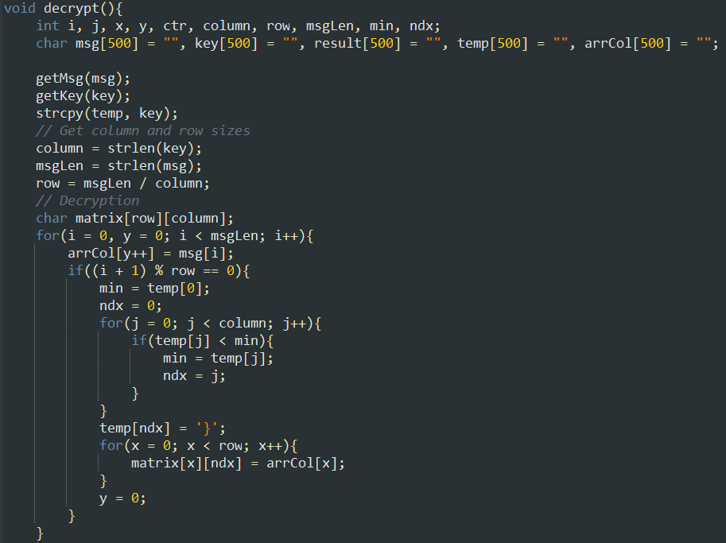
Streamline Code - Transposition Cipher
GROUP CODE - DECRYPTION

Slide 132
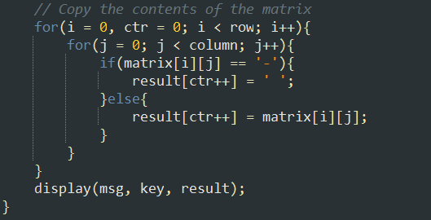
Streamline Code - Transposition Cipher
GROUP CODE - DECRYPTION

Slide 133
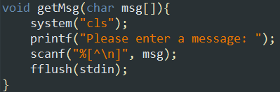
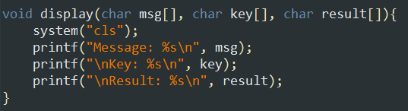
Streamline Code - Transposition Cipher
GROUP CODE - FUNCTIONS

Slide 134
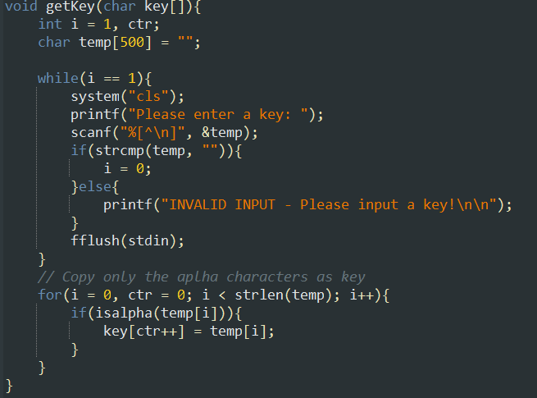
Streamline Code - Transposition Cipher
GROUP CODE - FUNCTIONS

Slide 135

THANK YOU FOR LISTENING!

